Slide 1

Analyzing Tablet Prices Of Flipkart​

Slide 2

ABOUT US
Name : Akshara
Qualification : BSC(Data Science)

Slide 3
Contents:
Problem Statement
Introduction
Tools (Libraries) used
Website URL’s for Web-Scrapping
Raw Data
Data Cleaning and Data Manipulation
Cleaned Data
EDA (Univariate, Bivariate and Multivariate Data analysis)
Conclusion

Slide 4
Problem Statement
Analysing Prices Of Tablets.
The current tabular representation of pricing data presents with its complexities and limitations for businesses.
The tabs provides insights into customer preferences and brand satisfaction , helping to discern which brands are more commonly associated.

Slide 5

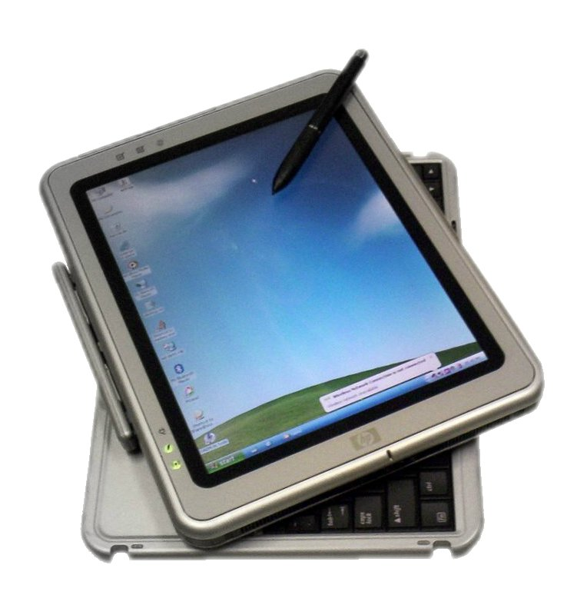
Introduction:
Brief overview of the pricing of Tabs using Flipkart.
Analysis of variation of price with respect to different features of Tabs.
Finding the best Tabs that has most benefits.
From this project , I am interested to provide good insights to choose better Tabs to smoothen life.

Slide 6

Libraries Used:
Regular Expressions
Beautiful soup
Numpy
Pandas
Matplotlib
Seaborn

Slide 7
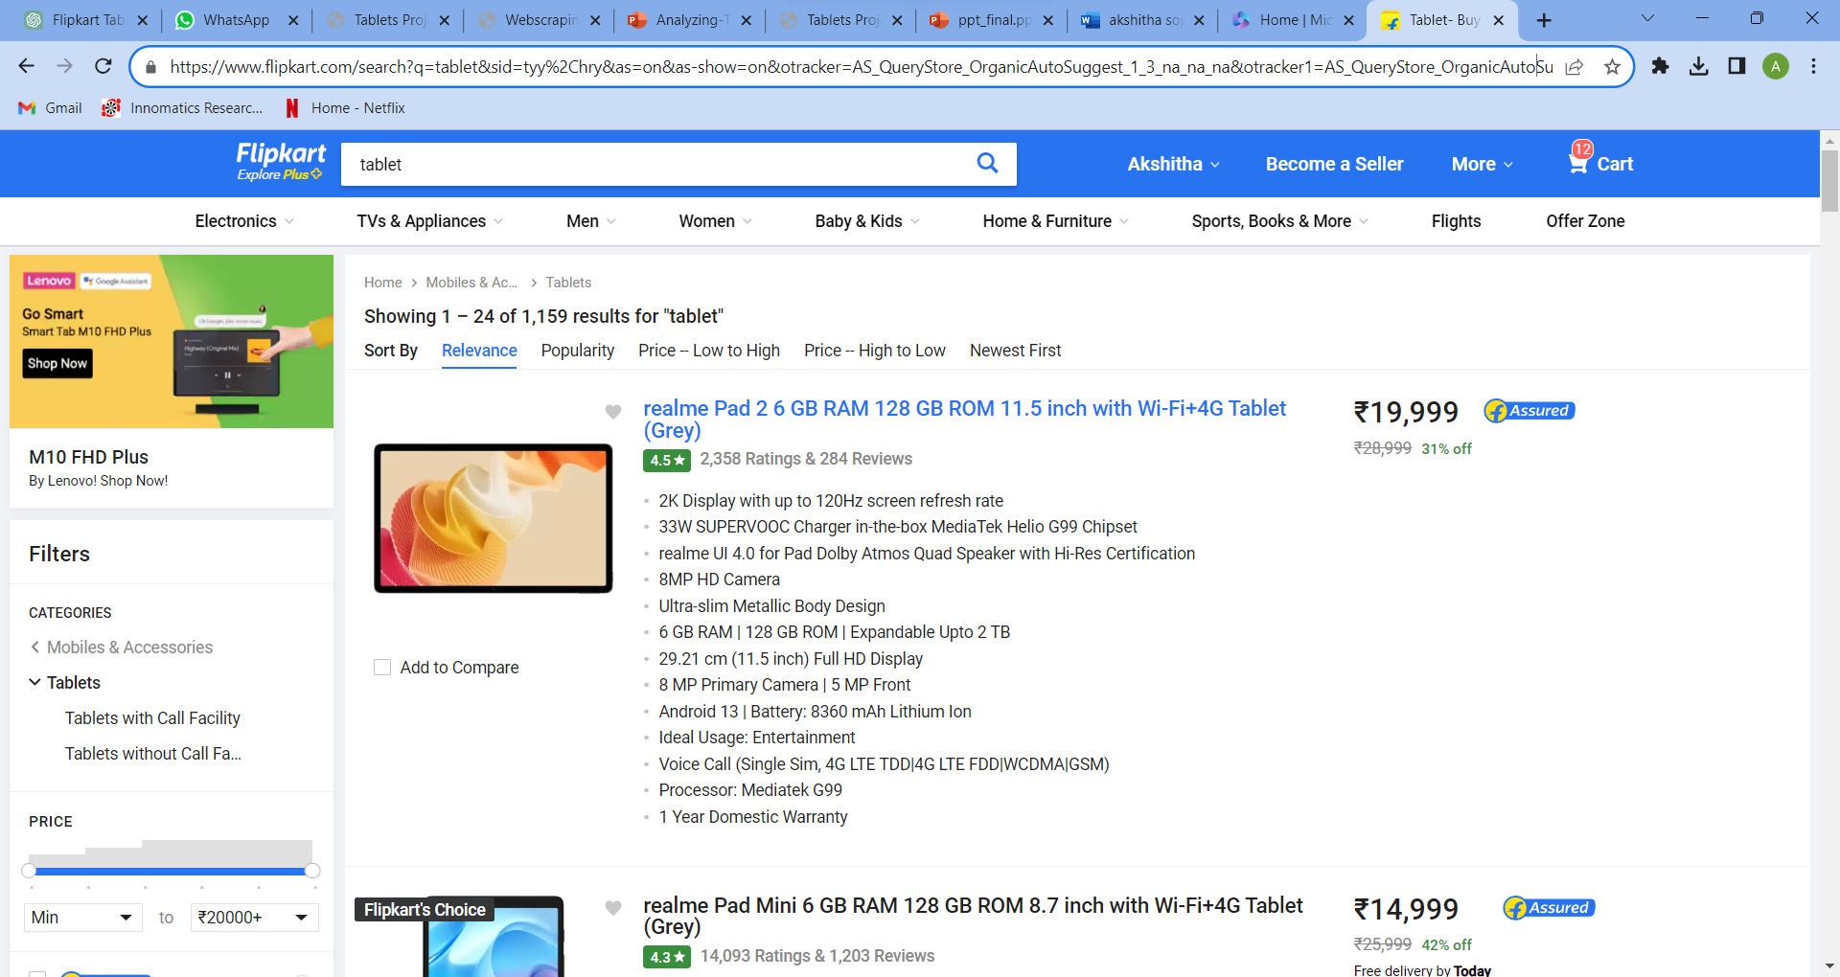
"
"
Website URL’s for Web-Scrapping :
https://www.flipkart.com/search?q=Tablets&otracker=search&otracker1=search&marketplace=FLIPKART&as-show=on&as=off

Slide 8
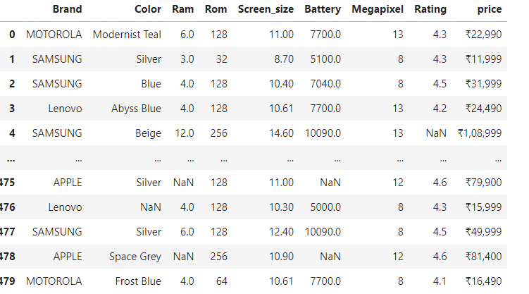
Raw data from website :​
Total: 480 rows × 9 columns of Raw Data

Slide 9
DATA CLEANING
1) Handling Missing Values
2) Removing Duplicate Values
3)Outlier Treatment
4)Data Analysis

Slide 10
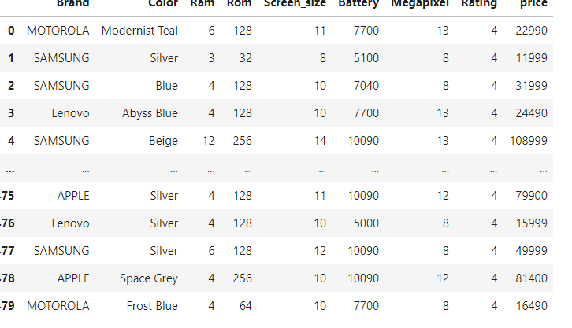
Cleaned Data Frame:

Slide 11

Features that Impact Tab Prices:
1
Ram
Higher the Ram, higher the price
2
Battery
Longer battery , higher the price.
3
Color
Higher the price, according to different colors.

Slide 12
EXPLORATORY DATA ANALYSIS(EDA)
Exploratory Data Analysis is majorly performed using the following methods:
Univariate analysis:- It provides summary for each field in the raw data set (or) summary only on one variable.
Bivariate analysis:- It is performed to find the relationship between each variable in the dataset and the target variable of interest (or) using 2 variables and finding the relationship between them
Multivariate analysis:- It is performed to understand interactions between different fields in the dataset (or) finding interactions between variables more than 2..

Slide 13
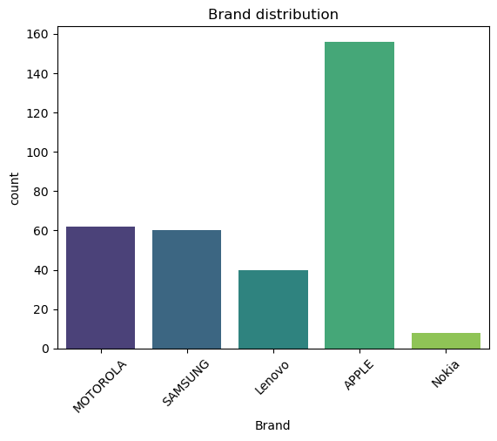
Univariate: Brand count plot
The count plot is useful for understanding the frequency or count of each category in the dataset, providing a quick overview of the distribution.
Brand Count Plot represent the no of brands in the tablets.
No .of count of the tabs available in each brand.
Apple and Motorola is the leading
company having huge variety of products.

Slide 14
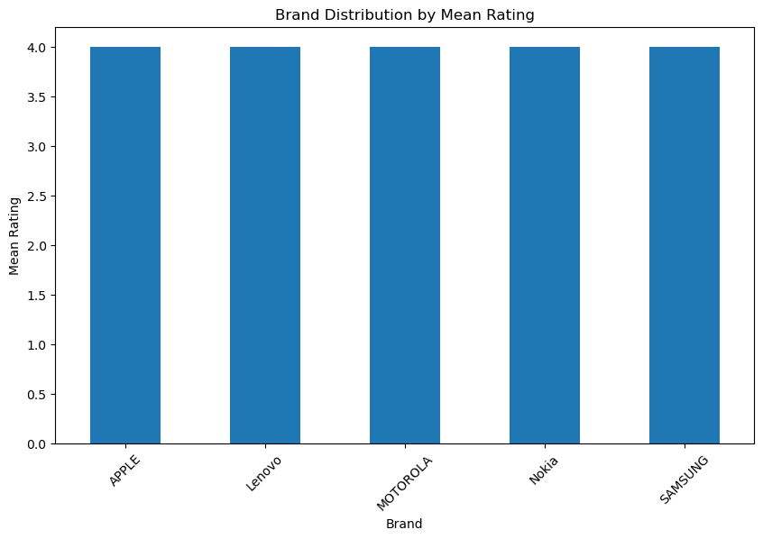
Bivariate: Brands with 5-star rating
The plot provides insights into which brands have a higher frequency of top ratings in the dataset.
The code aims to visualize the distribution of 5-star ratings among different brands using a count plot.
Getting brands of 5 star rating.
5 Star Tabs is more suggestible because it consumes more count compared to other ones.
Apple and Motorola products are having more rating.

Slide 15
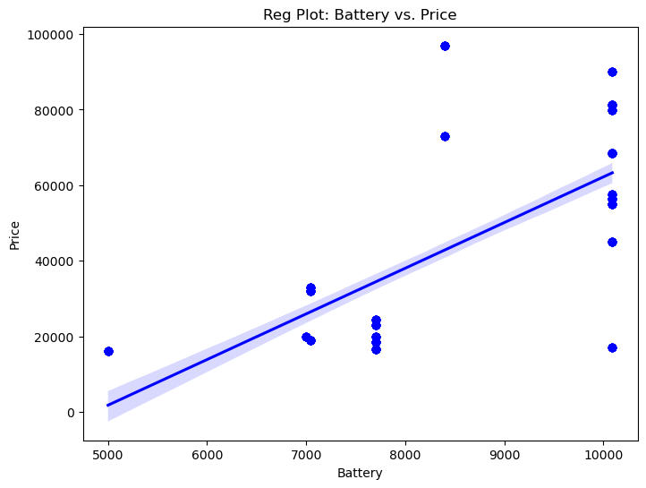
Bivariate : Battery vs Price
It is a continuous and continuous bivariate plot
It visually represent the linear relationship between the 'Battery' and 'Price' columns using a regression plot.
The plot provides insights into how changes in the battery capacity may be associated with changes in the price of tablets.
The distribution of batteries are more around 20000.

Slide 16
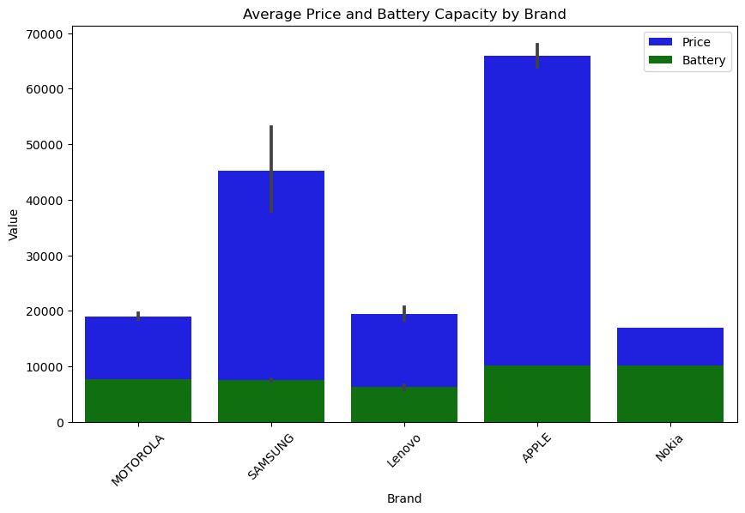
Multivariate : Price and Battery capacity
It visualizing to compare the average price and battery capacity of different brands using a grouped bar plot. This type of plot allows for easy comparison of two numerical values across different categories.
Average Price and Battery by Brand.
Most of the products are in range between
10K to 65K.
Apple is the most suitable one to buy.

Slide 17
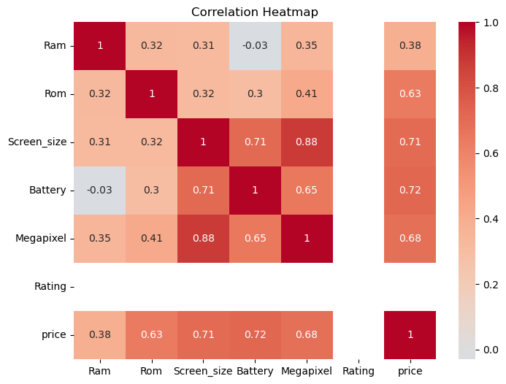
Relationship
The plot provides a visual representation of the correlation structure among numerical columns in the dataset.
The correlation heatmap helps identify patterns and strengths of relationships between variables.
The Battery and Ram shows there is no strong relationship between them.
The Rating has no correlation.
There is strong relationship between itself features.

Slide 18
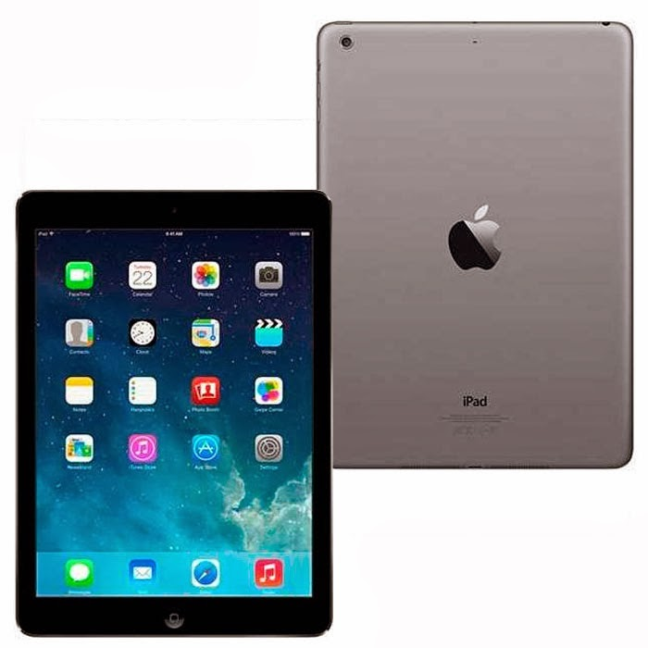
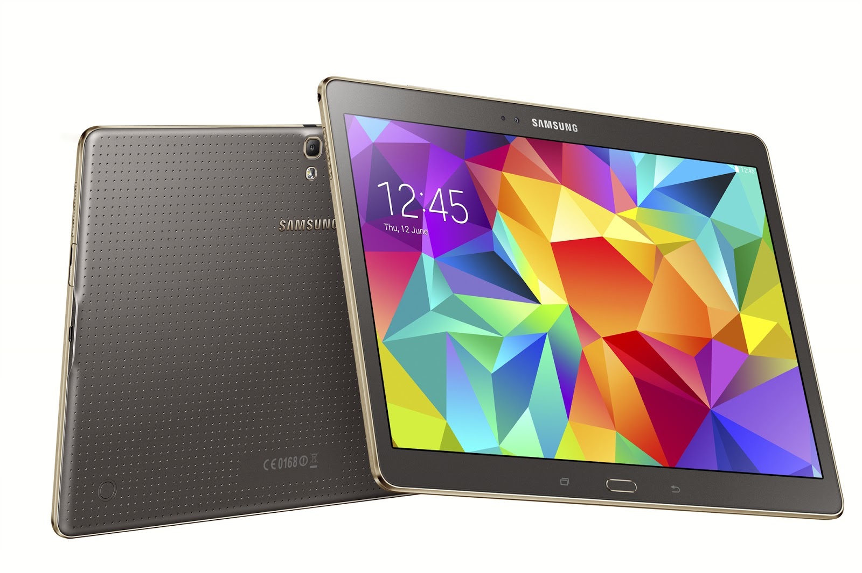
Conclusion:
Most selling products are in 10K to 65K.​
Most preferable battery brands are Apple and Motorola.
5-Star products are more recommended for new users.​
Most trusted company is Apple and Motorola
Product.
We can infer the most suitable brand is Apple and the second brand is Motorola, according to price distribution of the most common features Ram ,Battery and Ratings.

Slide 19

THANK YOU!

